Slide 1

Introduction to MapReduce Programming

Slide 2
MapReduce is a framework for processing large datasets using a large number of computers (nodes), collectively referred to as a cluster
Processing can occur on data stored in a file system (HDFS)
A method for distributing computation across multiple nodes
Each node processes the data that is stored at that node
Consists of two main phases
  Mapper Phase
  Reduce phase

Slide 3
Simple view of Map Reduce
Map
I/P File
Reduce
HDFS
Map

Slide 4
MAPPER FLOW
Input data set is split into independent blocks – processed in parallel.
Each input split is converted in Key Value pairs.
Mapper logic processes each key value pair and produces and intermediate key value pairs based on the implementation logic.
Resultant key value pairs can be of different type from that of input key value pairs.
The output of Mapper is passed to the reducer.

Slide 5
REDUCER FLOW
Output of Mapper function is the input for Reducer
Reducer sorts the intermediate key value pairs
Applies reducer logic upon the key value pairs and produces the output in desired format
Output is stored in HDFS

Slide 6
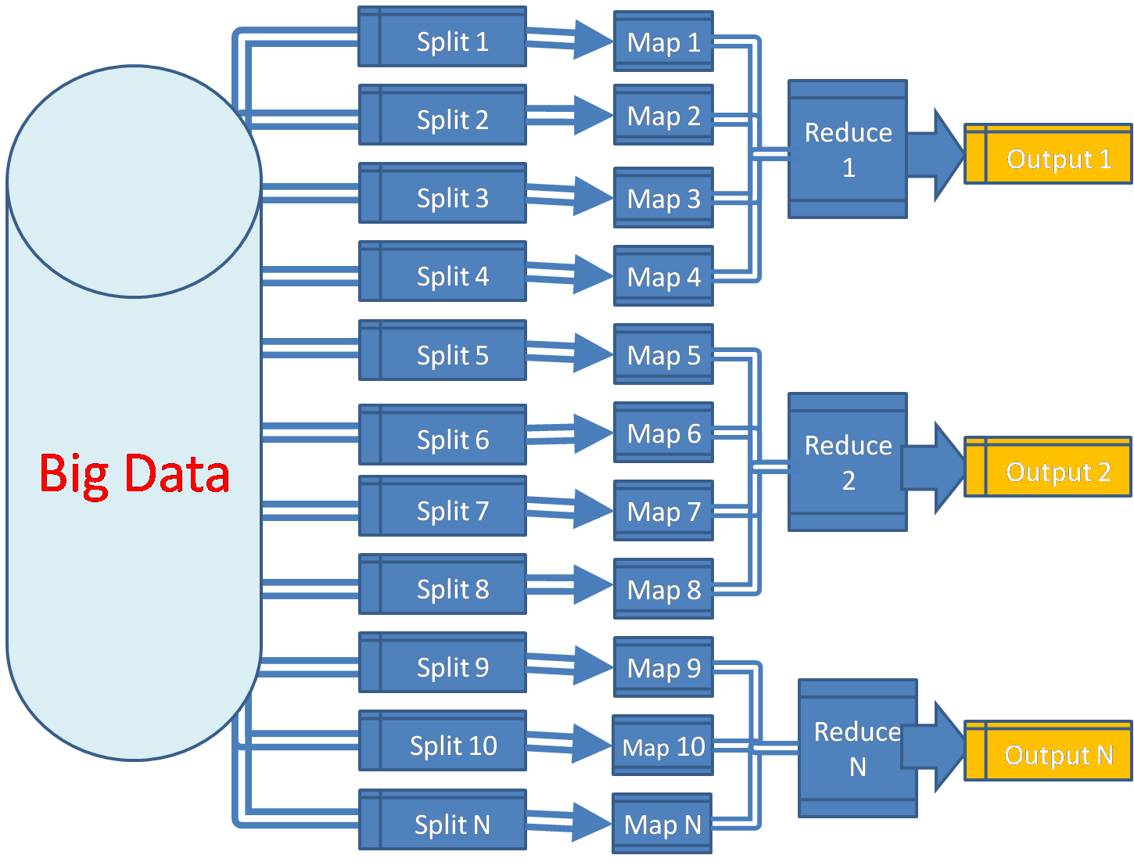

Slide 7
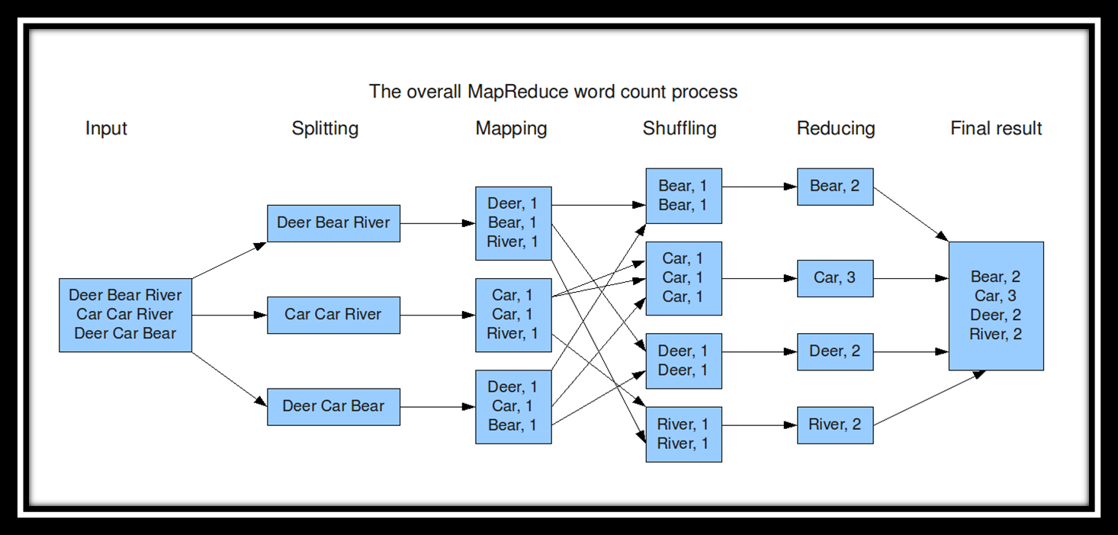
MapReduce: Word Count

Slide 8

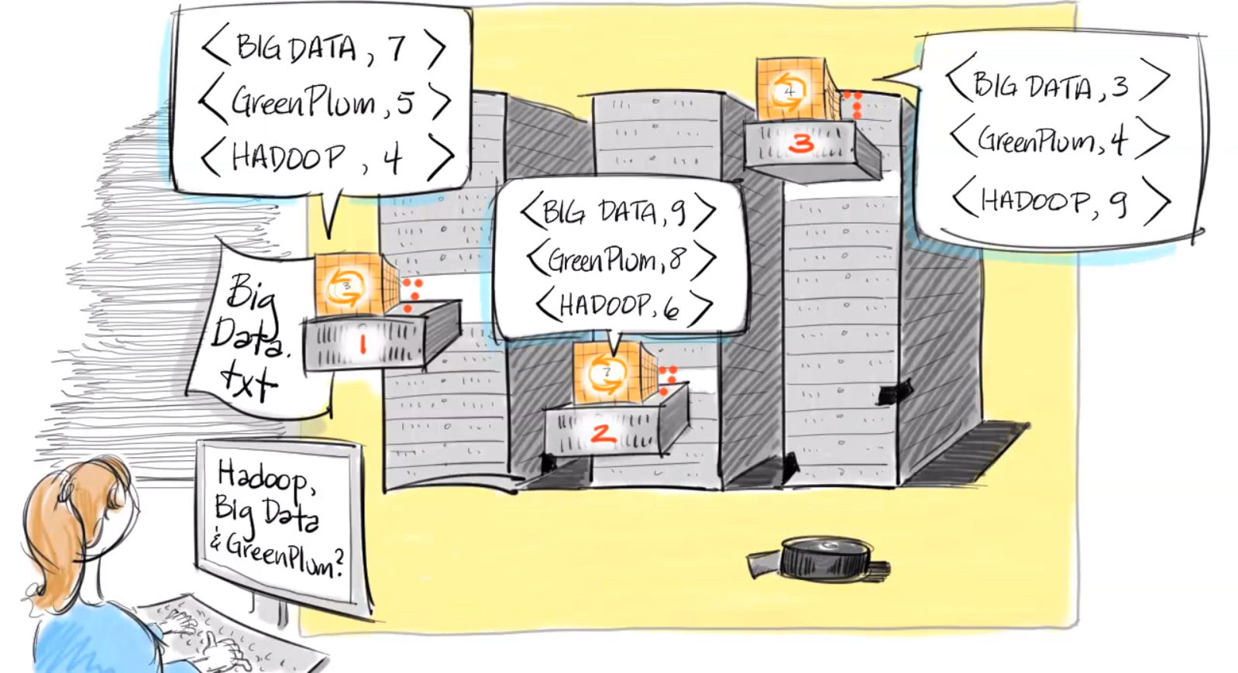

Slide 9
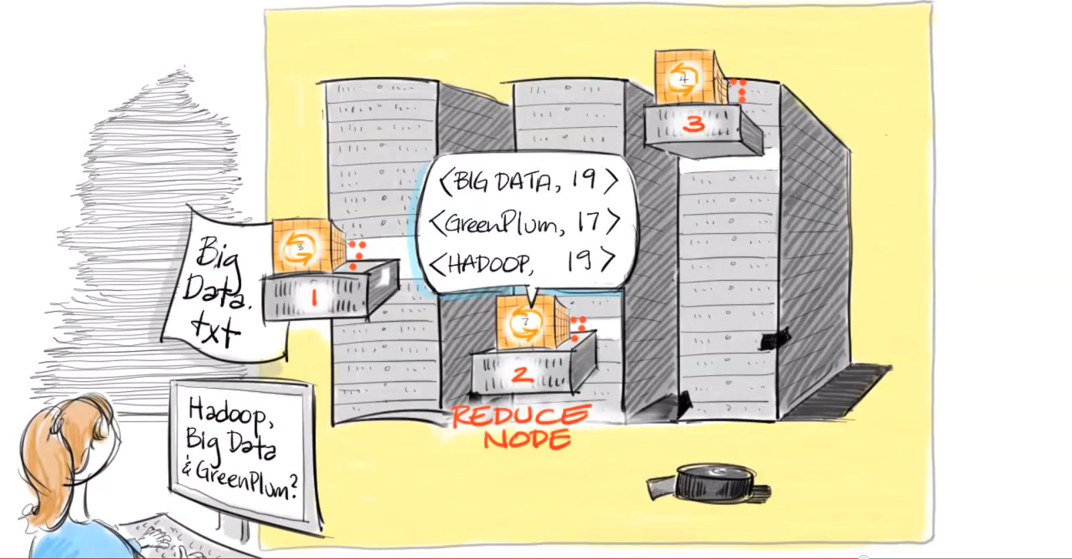

Slide 10
Motivation Questions
Problem 1: Data is too big to store on one machine.
HDFS: Store the data on multiple machines

Slide 11
Motivation Questions
Problem 2: Very high end machines are too expensive
HDFS: Run on commodity hardware

Slide 12
Motivation Questions
Problem 3: Commodity hardware will fail!
HDFS: Software is intelligent enough to handle hardware failure
Notes:
1%-10%-100%

Slide 13
Motivation Questions
Problem 4: What happens to the data if the machine stores the data fails?
HDFS: Replicate the data

Slide 14
Motivation Questions
Problem 5: How can distributed machines organize the data in a coordinated way?
HDFS: Master-Slave Architecture

Slide 15


